Slide 1
Financial Literacy for Education Success
FLES is an online Financial Literacy library of searchable resources for learners and educators P-20 and beyond
&
The Navigate publication set explores college costs
Notes:
A) Many resources are available online to provide necessary information about costs to consider when choosing to attend a trade school, community college or college after high school. The information provided is hard to find and also hard to understand. NIU, Econ IL, and educational partners gathered to identify and create a simple plan of action to support student success in reaching post-secondary goals.
B) The Navigate publication set from the Federal Reserve Bank of Dallas informs students of potential costs associated with attending college.

Slide 2
What’s Happening
Financial literacy resources continue to be identified for and
populated into a searchable online library to simplify finding
credible information.
Resources include:
Curriculum Games and Activities
Infographics Online Manipulatives and Tools
Mobile Apps Blogs and white papers
Videos Websites for consumers
Resources continue to be populated into the library
Site is available and functioning while in progress
App will be created to link mobile devices to the homepage
Infographic to be created for a ‘roadmap to success’
Financial Literacy workshops will be available to support schools in
college cost preparation for students and for families
Notes:
While resources with integrity continue to be identified, infographics and other tools are being created to further support finding information quickly. The FLES library has been designed for educational and personal uses.

Slide 3
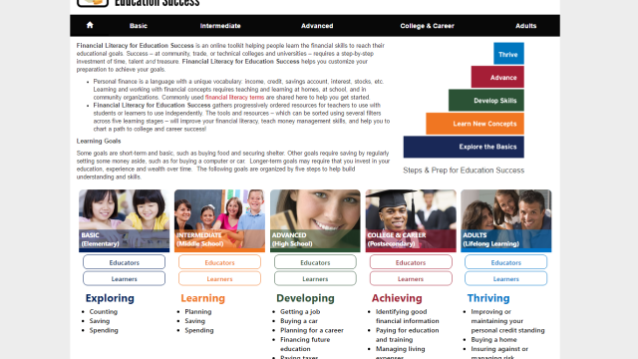
Financial Literacy for Education Success
Notes:
This is the FLES launching page that provides access to the online FLES library of financial literacy resources and tools.

Slide 4
Navigate!
Navigate students toward success
Today you will receive your own copy of the Navigate set of publications:
The Teacher/Counselor/Adult Handbook
The Student Workbook
Federal Reserve Bank of Dallas – Navigate publication
Notes:
The Navigate set of publications are designed to inform students and families of the decisions and costs involved with post-secondary education (trade school, community college, 4-yr college). They are available without cost or shipping/handling. Schools can order any number of each publication, depending on how they choose to utilize the books.

Slide 5
Federal Reserve Bank of Dallas – Navigate – pg 17
Notes:
This slide shows how the books highlight example career paths – to explain the costs and benefits to consider when choosing post-secondary options.

Slide 6
Federal Reserve Bank of Dallas – Navigate – pg 18
Notes:
The expense categories seem simple and basic, but looking at the various college and personal costs associated with post-secondary coursework - there are expenses many students don’t always consider! It can be those additional costs that can add up and prevent a student from completing a certification program or degree.

Slide 7
A lower estimate of $1,200 per year is more typical
Federal Reserve Bank of Dallas – Navigate – pg 21
Notes:
This slide shows an activity that each student will work differently, depending on choices that are most important to their situation and interests. Manipulating the budget shows students that some expenses are possible to minimize, if needed.

Slide 8
http://www.dallasfed.org/assets/documents/educate/navigate/navigate-slides5.pdf
Federal Reserve Bank of Dallas – Navigate Publication
https://bigfuture.collegeboard.org/pay-for-college/financial-aid-awards/compare-aid-calculator
College Board - Compare Your Financial Aid Awards
Notes:
A link to a quiz that most students and their parents will find informative and fun – because their answers will be different at times! The College Board link is a unique tool that every family will appreciate.

Slide 9
Financial Aid Terms
Financial Aid
Financial Aid is any grant or scholarship, loan, or paid employment offered to help a student meet his/her college expenses. Such aid is usually provided by various sources such as federal and state agencies, colleges, high schools, foundations, and corporations.
Work Study
The Federal Work Study program provides funds to eligible students for part-time employment to help finance the costs of postsecondary education. In most cases, the school or employer has to pay up to 50 percent of the student's wages, with the federal government covering the rest.
Grant
Did someone say free money? Unlike loans, grants­­­­—which can come from the state or federal government, from the college itself, or from private sources—provide money for college that doesn't have to be paid back.
Scholarship
Similar to a grant, scholarships are primarily awarded for academic merit (good grades) or for something you have accomplished (volunteer work or a specific project); however, there are many need-based scholarships out there, as well. Like grants, scholarships don't have to be repaid.
Loan
Federal student loans don't have to be paid while you're in college, and there are also a variety of loan forgiveness programs out there post-graduation. The rates and terms are generally more flexible than private loans.
Tuition
College tuition is the "sticker price" of your education, and does not include room and board, textbooks, or other fees.
Notes:
Most students and their families are unfamiliar with many of the FAFSA and other financial literacy terms. These terms are important to understand before making post-secondary decisions!

Slide 10
College and Career Online Tools & Resources
FLES
Building Wealth
College Costs
High School Tools
Interest Calculator
ISAC
Mobile Phones Matter
Navigate
Illinois Workforce
Notes:
FREE College and Career Online Tools & Resources

Slide 11
Thank You!
Beth Metzler
VP for Programs & Partnerships
And STEM Finance Learning Exchange
Econ Illinois
Northern Illinois University
bmetzler@niu.edu
815.753.6930
Notes:
Contact Beth Metzler for additional information or to request a customized presentation or workshop to support student success in the classroom!

